Slide 1



CRACKING THE
CODE
to Writing An
Effective Federal Resume
with Corliss Jackson
www.manifestcareers.com

Slide 2

MANIFEST CAREERS
(Formerly Federal job results)
established 2007
Corliss Jackson
President and CEO
25 years of Federal HR recruiting and staffing experience, started at NIH
Director of HR for the US Election Assistance Commission
Author of Washington Post’s Federal jobs column, Corliss’ Corner
Author of Cracking the Federal Job Code: Top Secret Tips for Today’s Federal Job Seeker
“I support professionals moving from federal service to entrepreneurship, guide career pivots during periods of uncertainty, and advise organizations on growth, leadership, and workforce transformation.”

Slide 3

TODAY
COURSE PORTAL: https://federaljobresults.com/federal-resume-boot-camp/
Keep class in class
Grocery store approach
Take notes... jot down phrases you hear, nuggets, responses to exercises
Breaks will be frequent
Restroom

Slide 4

TODAY
COURSE PORTAL: https://federaljobresults.com/federal-resume-boot-camp/
Understand the FEDERAL PROCESS
Know which federal jobs you QUALIFY for
Evaluate the JOB ANNOUNCEMENT
Craft your federal resume using powerful ACCOMPLISHMENT STATEMENTS
TAILOR your federal resume for each job
Be Proactive about your CAREER GROWTH

Slide 5

EXERCISE
What’s something you do now that would have intimidated you earlier in your career?

Slide 6

FEDERAL JOB ROADMAP
Apply
HR Rates & Ranks Application
Top Applicants Referred
Panel Interview
Job Offer
Best Qualified
Not Qualified
Minimally Qualified
Resume Key Words
Read & Rate
Assessment Questionnaire and/or Hiring Assessments

Slide 7
Qualifying for federal jobs
23 Occupational Groups
Identify your target

Slide 8
Qualifying for federal jobs job series number
0201 Human Resource Specialist
0301 Protocol Specialist
0301 Program Specialist
0303 Administrative Technician
0341 Administrative Officer
0343 Program Analyst
0401 Biologist
0511 Auditor
0640 Health Technician
0644 Scientist
1082 Writer/Editor
1109 Grants Management
Over 400 across the government
Most individuals will qualify for 1-3

Slide 9
Understanding THE
Job ANNOUNCEMENT
Read through entirely
Challenge: which sections are important?
Crucial to know essential parts:
Will you qualify?
How to demonstrate on your resume?

Slide 10
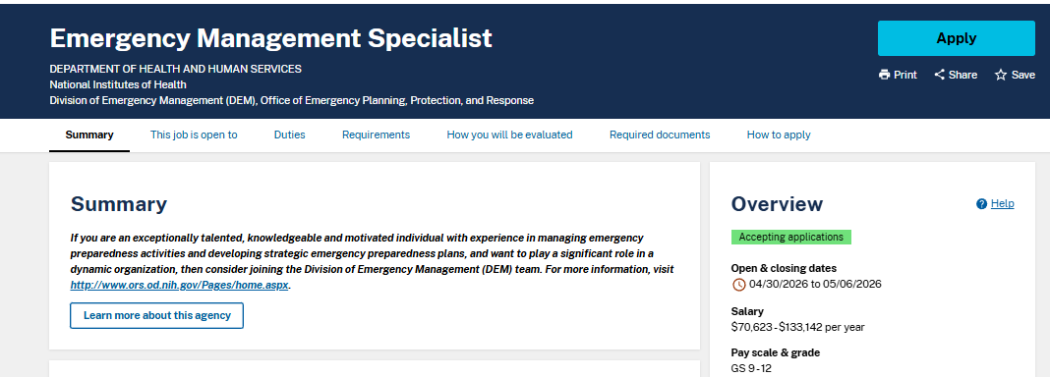

Slide 11
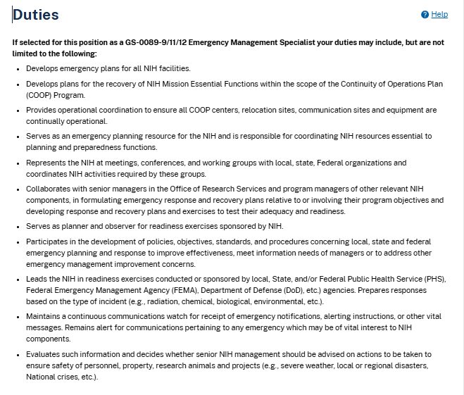
Evaluating the job announcement Duties
80% match
Weighted
Listed in descending order

Slide 12
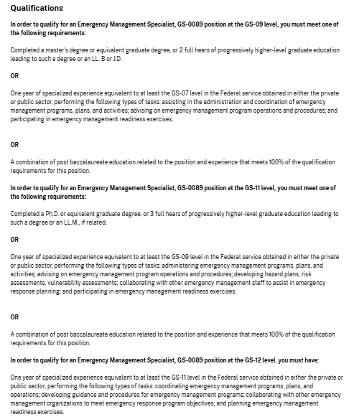
Evaluating the job announcement qualifications
100% match
12 months of experience
Resume must prove you meet qualifications
Paid and unpaid experience works

Slide 13
Evaluating the job announcement how you will be evaluated
You will be evaluated based on how well you meet the qualifications listed in this vacancy announcement. Your qualifications will be evaluated based on your application materials (e.g., resume, supporting documents), your responses on the application questionnaire, and your responses to all assessments required for this position. You will be assessed on the following competencies:
Attention to Detail
Customer Service
Flexibility
Integrity/Honesty
Interpersonal Skills
Learning
Reading Comprehension
Self-Management
Stress Tolerance
Teamwork
Overstating your qualifications and/or experience in your application materials or application questionnaire may result in your removal from consideration.
100% match
Resume must demonstrate what they are asking for to the extent possible

Slide 14
assessment questionnaire (**This may or may not be in the job announcement)
Assessment Questionnaire
Work closely with top management to identify and resolve problems.
I have not had education, training or experience in performing this task.
I have had education or training in performing this task but have not yet performed it on the job.
I have performed this task on the job, with close supervision from supervisor or senior employee.
I have performed this task as a regular part of the job, independently and usually without review by supervisor or senior employee.
This task has been a central or major part of my work. I have performed it myself routinely, and I have trained others in performance of this task and/or others have consulted me as an expert for assistance in performing this task.
Read the questions carefully. Are you comfortable answering all of the questions at the highest level.
Give yourself full credit for all of your experience when answering these. Paid, unpaid, social, civic experiences.
Do not be dishonest - but if you can make a case to support the qualification, then do so.
Make sure your resume corroborates your responses.

Slide 15

This Photo by Unknown Author is licensed under CC BY-SA

Slide 16


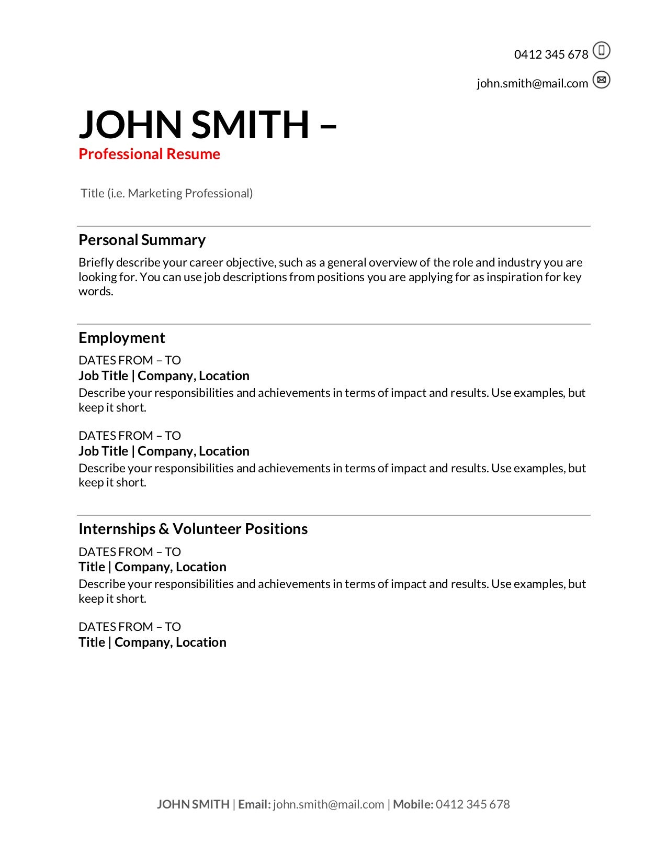
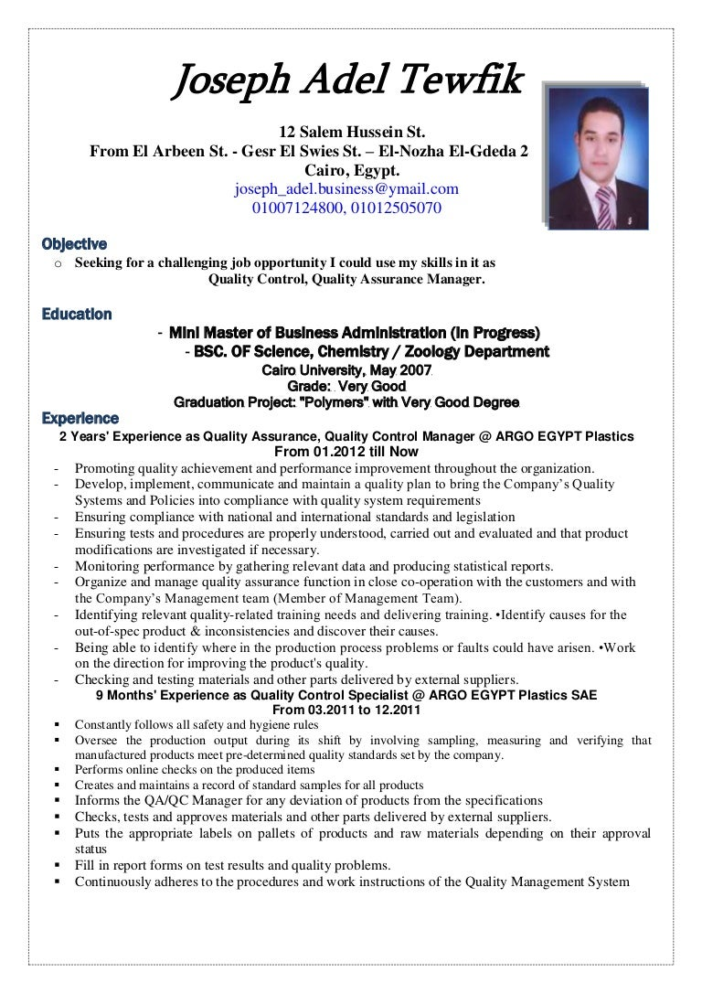
WRITING YOUR 2-PAGE
FEDERAL RESUME

Slide 17
EXERCISE
What do people come to you for?

Slide 18
CHALLENGE
The biggest challenge with the updated guidelines for the federal resume is demonstrating your value within the 2-page limit.
Tips from USAJobs: (https://help.usajobs.gov/faq/application/documents/resume/what-to-include#what-file-type-should-i-use)
“Your resume must be 5 MB or less. We recommend saving and uploading your resume as a PDF to maintain formatting and number of pages. We also accept GIF, JPG, JPEG, PNG, RTF, TXT, ODT or Word (DOC or DOCX). We do not accept PDF portfolio files. Use a standard 8.5x11-inch size for your document.
We recommend using a sans-serif font size like Lato, if available. Other recommended options are Calibri, Helvetica, Arial, Verdana, Open Sans, Source Sans Pro, Roboto or Noto Sans. Make your page margins 0.5 inches. Consider using 14-point size font for titles and 10-point for the main text in your resume.”

Slide 19

FEDERAL RESUME
1. 2 pages. New as of 2025.
2. Simple Format. Make it very easy for the reader.
No graphics, text boxes, etc.
Create in MS Word (not the resume builder). Do not use pre-formatted templates.
3. Universal Font. See USA Jobs suggestions.
4. 10-point Font or higher. Use 10, 11, or 12 point font for text. Larger text for headings.
5. No personal information. Do not include family status, photos, social security number, etc.
6. Grammar. Use present tense for current job; past tense for previous jobs.

Slide 20
FEDERAL RESUME
7. Use bullets. Ideally, 3 accomplishment statements for each job.
8. Heading. Lead each accomplishment statement with a bolded heading, which can easily be changed based on your target position.
9. Dates. List employment in months and years going backward from today: MM/YYYY - MM/YYYY. Read announcement if they want MM/DD/YYYY.
10. Chronological (Reverse Chronological). Go backwards from today through 2016.
11. Qualifications. Address every required qualification in the job announcement. For example, if the qualifications section says you need experience with MS Project, you need to use “MS Project” in your resume.

Slide 21
FEDERAL RESUME BASIC SECTIONS
Personal Information
Name, Email, Phone
Job Title Section
Core Skills / Technical Skills / Certifications
Professional (Work) Experience
2-3 line summary of Job (include scope, areas of responsibility, staff oversight, budget oversight, etc. )
Optional Responsibilities with Category Headings
Accomplishment Statements (3+ per job)

Slide 22
FEDERAL RESUME ADD-ONS
Linked In
Security Clearance
Prior Work Experience
Honors & Awards
DO NOT INCLUDE:
Training, References

Slide 23
EXERCISE
What is one problem you are known for fixing?

Slide 24

Let’s look at a sample….

Slide 25
MARIAH JACKSON
Ashburn, VA 20147 | 703-509-8677 | MJ@gmail.com| U.S. Citizen. Clearance: Secret
EXPERT AUDITOR | FINANCIAL COMPLIANCE PROFESSIONAL
Core Competencies
Audit Program Planning & Management | Risk Assessment & Compliance | Internal Controls | Financial Analysis
Stakeholder Engagement & Communication | Team Leadership & Mentoring | Executive Communication

Slide 26
Professional Experience
03/27/2023 – Present | AUDITOR-IN-CHARGE | Agency | Washington, DC 20024 | 0511-EL-12 | FT: 40/week
Lead and conduct performance, compliance, and systems audits of Agency programs, supervising teams of ## auditors, analyzing portfolios valued at $XXM across ## beneficiaries, and providing senior leadership with technical guidance and risk-based recommendations to ensure compliance, operational efficiency, and effective risk mitigation.
Audit Leadership & Risk Management: Lead audit teams to plan and execute audits, applying GAAP and GAGAS to assess internal controls and operational compliance and identify deficiencies and recommend improvements.
Executive Communication & Influencing: Deliver high-impact briefings to senior executives, translating complex audit issues into actionable decisions that improve oversight of programs serving ## beneficiaries.
Quality Assurance & Technical Compliance: Review and edit workpapers and audit deliverables to ensure 100% compliance with GAGAS quality standards.
Data Analytics & Evidence Development: Perform data analysis on financial records and transactions, producing evidence-based findings to increase reporting accuracy.
Internal Controls & Evaluation: Identify and document internal control weaknesses to reduce operational risk exposure.
Key Accomplishments
Cross-Agency Collaboration & Issue Resolution: Collaborated with ## cross-functional stakeholders, accelerating resolution of audit issues by ## days/weeks.
Audit Planning & Technical Expertise: Developed and modified audit plans, adjusting areas of emphasis and timelines to address high-risk program areas, resulting in ##% more effective issue identification.
Policy & Regulatory Interpretation: Reviewed agency policies, regulations, and procedures, identifying gaps and recommending corrective actions, reducing repeat compliance findings by ##%.
Program Evaluation: Conducted detailed financial and risk analysis of legislation, financial statements, and program data, improving risk assessment accuracy and mitigating potential financial exposure by ##%.

Slide 27
EXERCISE
Before I touched it…
After I touched it…

Slide 28
ACCOMPLISHMENT STATEMENTS
Key to stand out from the competition
List as bullets under the job summary
Minimum of 3
Demonstrate how you added value to the organization

Slide 29
ACCOMPLISHMENT STATEMENTS
An ACTION VERB describing what you did rather than your responsibilities.
The SCOPE of your activities (size of unit managed, size of budget managed, or a number of personnel affected). Quantitative data is a plus, but qualitative evidence is great as well.
Highlight KEY SKILLS you used in the pursuit of the accomplishment.
The RESULTS of your activities—quantifiable-cost savings, time reduced, knowledge transferred, deadlines met (internal or external), value-added for customers, awards or commendations.

Slide 30
EXERCISE
Jot down any numbers connected to your work--budgets, people, customers, timelines, volume, frequency.
No explanations.

Slide 31
ACCOMPLISHMENT STATEMENTS
Questions to Ask Yourself
What did you do that was above and beyond your normal job duties?
How did you stand out among other employees?
Were you ever recognized by a supervisor for a job well done? When and why?
Did you win any awards or accolades?
What new processes did you implement to improve things?
What problems did you solve?
Did you ever consistently meet or exceed goals or quotas?
Did you save the company/organization/agency money?
What made you great at your job?
How were your previous employers better off because you worked there?
What are you most proud of in your previous jobs?
What did your performance evaluations say?
What specific actions did you take to address a particular challenge?
What did others come to you for help with?
What was the action, duration, population, and results?

Slide 32
EXERCISE
If I left my job tomorrow, what would slow down, be broken or be noticeably missed?

Slide 33



‘STAR’ STORY
Interview
Networking
Resume
S ituation
T ask
A ction
R esult

Slide 34
S T A R STORY
SITUATION: In my role as Training Specialist, I was responsible for identifying the best process for training regional office employees.
TASK: I was tasked with determining the best method for training regional employees, based on budgetary constraints.
ACTION: I gathered data relative to organizational goals and objectives, budget projections, travel expenses, training delivery evaluations and other associated issues. I analyzed the data and developed viable options for training regional employees. I developed and prioritized several recommendations for senior level management in the form of a written report and flow chart that mapped out the pros and cons of the various options.
RESULT: Although the timeline was tight, the training was released to the regions using my recommended method and was deemed to be widely successful.

Slide 35
ACCOMPLISHMENT STATEMENT
Training Program Revamp: Analyzed training delivery costs, travel logistics, and program effectiveness for a geographically-dispersed workforce, developing prioritized recommendations that reduced projected training expenses by approximately 25–35% while maintaining training quality and meeting aggressive implementation deadlines.
Senior Leadership Briefings: Developed executive-level briefing materials, including comparative cost-benefit analyses and process flow diagrams, to support senior leadership decision-making on workforce training investments.

Slide 36
This Photo by Unknown Author is licensed under CC BY-SA

Slide 37
EXERCISE
Write your #1 STAR story

Slide 38
EXERCISE
Shorten your STAR story into a 1-2 sentence (2-4 lines) accomplishment statement

Slide 39
EXERCISE
Create the summary
for your current job.
2-3 lines
include scope, areas of responsibility, staff oversight, budget oversight, etc. )

Slide 40
TAILOR YOUR FEDERAL RESUME
Go back to the sections within the job announcement:
#1 Qualifications
Must clearly demonstrate that you possess this Specialized Experience.
#2 How You Will Be Evaluated
Must clearly show that you possess these competencies.
#3 Assessment Questionnaire **IF PRESENT**
Your resume must support your answers.
#4 Duties
Extract key phrases, words, or terms from the announcement.
*******************************************************************************
Incorporate these elements throughout your resume
UNDER THE POSITIONS WHERE YOU HAVE DONE THEM.
They can go within your skills paragraphs or
within your accomplishment statements.

Slide 41
FEDERAL RESUME
Your goal is to make it easy for the human resources specialist to clearly see that you have the qualifications to match the job requirements.
Know which occupational group and job series numbers are for you.
Read the job announcement carefully and make sure you have the required qualifications and experience.
Craft a federal resume that contains all of the required information.
Tailor your resume each time you apply.

Slide 42
This Photo by Unknown Author is licensed under CC BY-SA

Slide 43

CAREER GROWTH
Think about how you will move up
Will I target similar positions in the same organization?
Will I target different positions in the same organization?
Will I target similar positions in a different organization/field?
Will I target different positions in a different organization/field?

Slide 44

CAREER GROWTH
Networking
Informational interviews
Join professional groups or associations
Research
Increase your skills
Find a Mentor (or 2!)
Ask for increased responsibilities
Volunteer
Find a shadow assignment
Develop an Individual Development Plan (IDP)
Find a detail
Take a change to lower grade
Look for multi-graded career ladder positions

Slide 45

MANIFEST CAREERS
info@manifestcareers.com
manifestcareers.com
703-509-8677

